Slide 1



ShaleWellCube
CASE STUDY
SOLUTION
Comprehensive Well Evaluation:
A Deep Dive into Well Analysis Case Study
Batch: Shell7-SK-23-B4
Group: Harsh Gaurav Anuj Rawat Afrin Siddiqui Aadil Sehrawat Meghna Sabharwal

Slide 2
PROBLEM STATEMENT
Objectives
Analyze historical monthly production records
Assess intricate well attributes
Enhance insights with projections, cost analysis, and more
Main Goals
Precisely forecast US production trends
Benchmark well, operator, and basin performance
Extract valuable insights from ShaleWellCube
Outcome
Informed decision-making through strategic data utilization

Slide 3
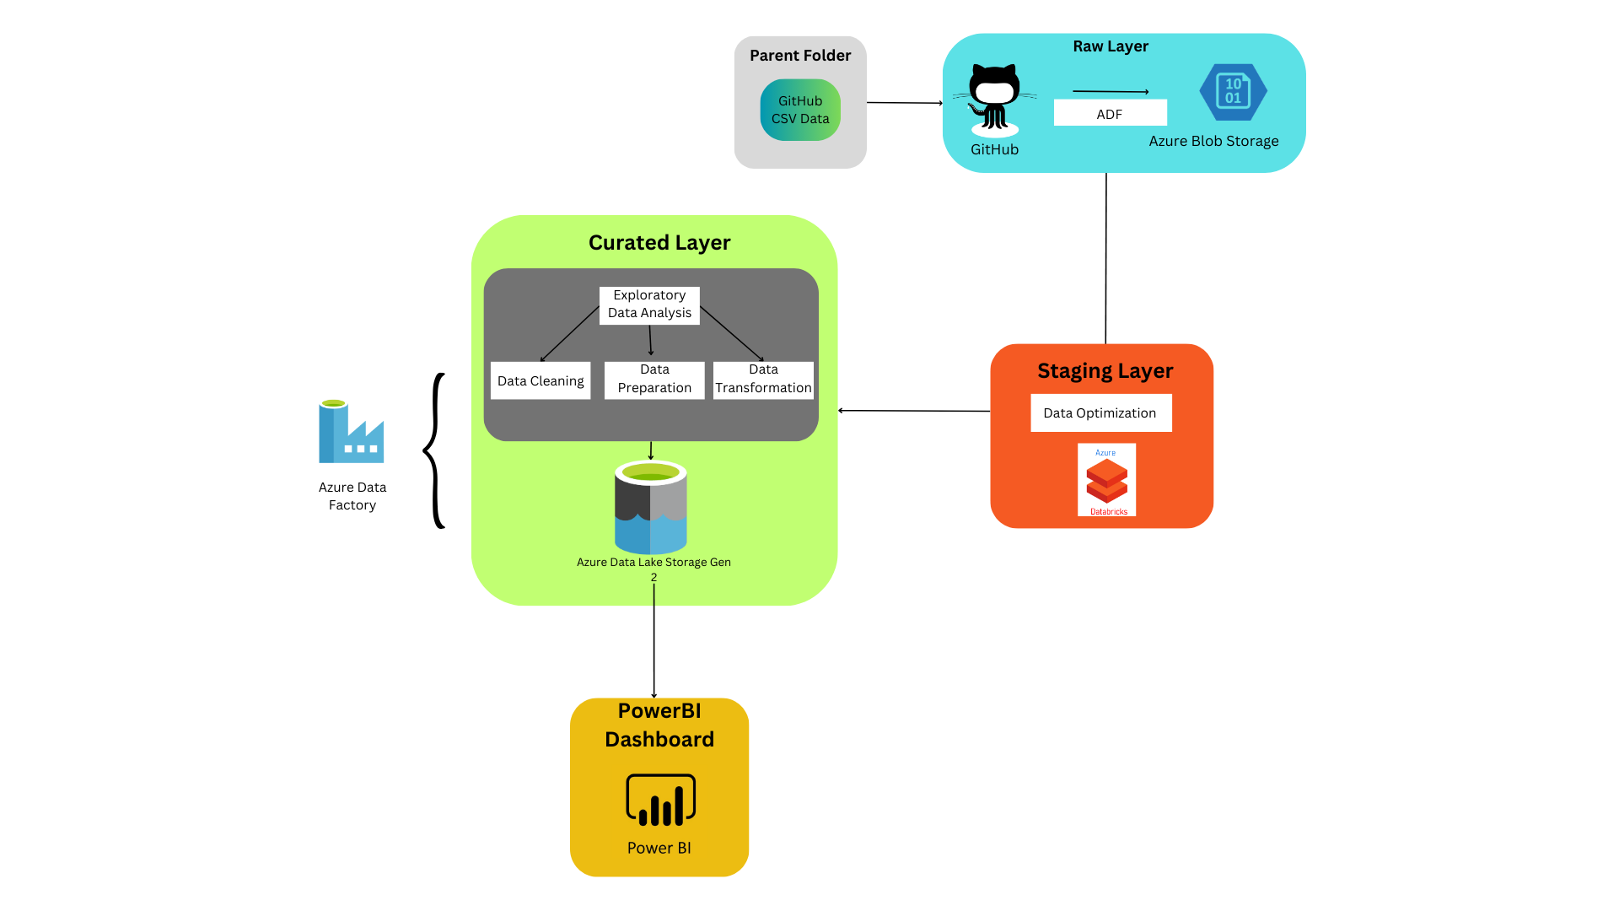
DATA FLOW DIAGRAM OF TECHNICAL COMPONENTS AND LAYERS

Slide 4


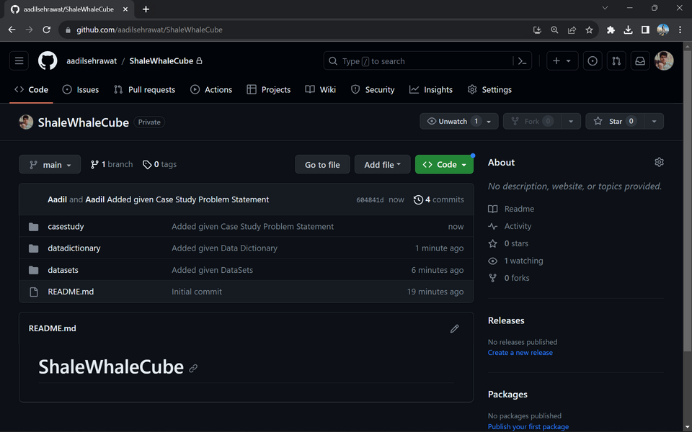
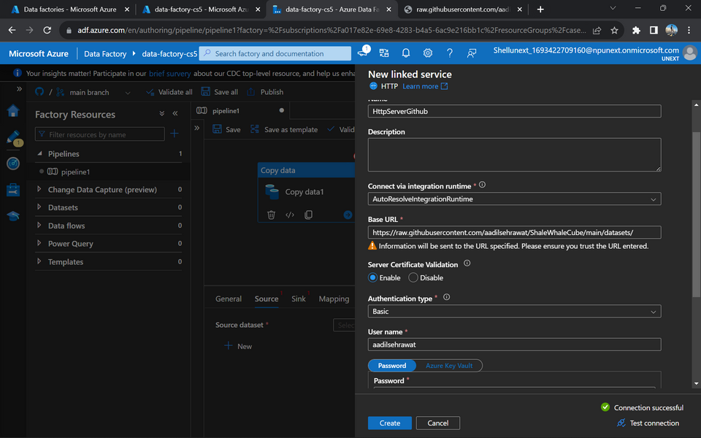
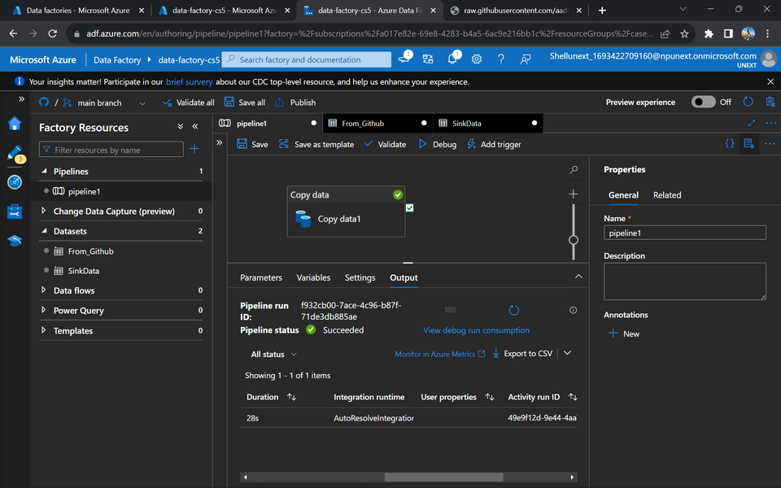
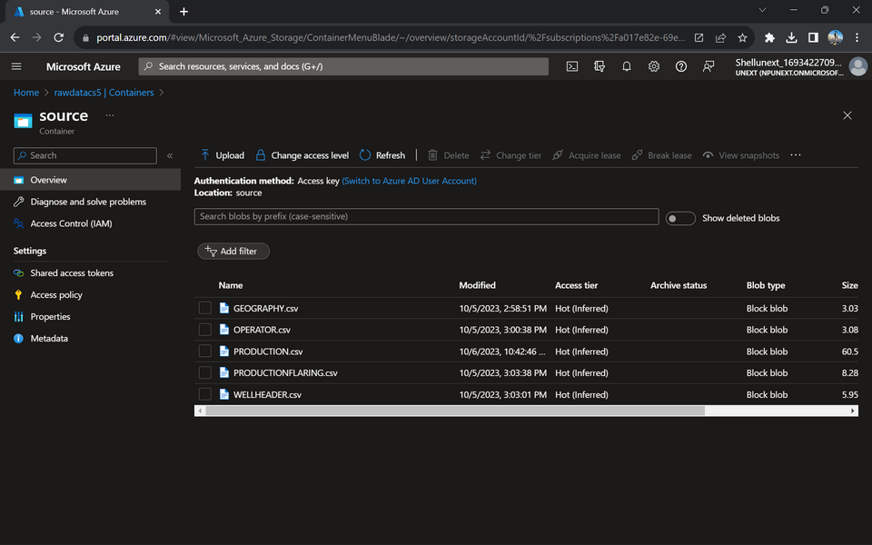
SNAPSHOTS OF DEVELOPMENTS IN EACH LAYER
RAW

Slide 5
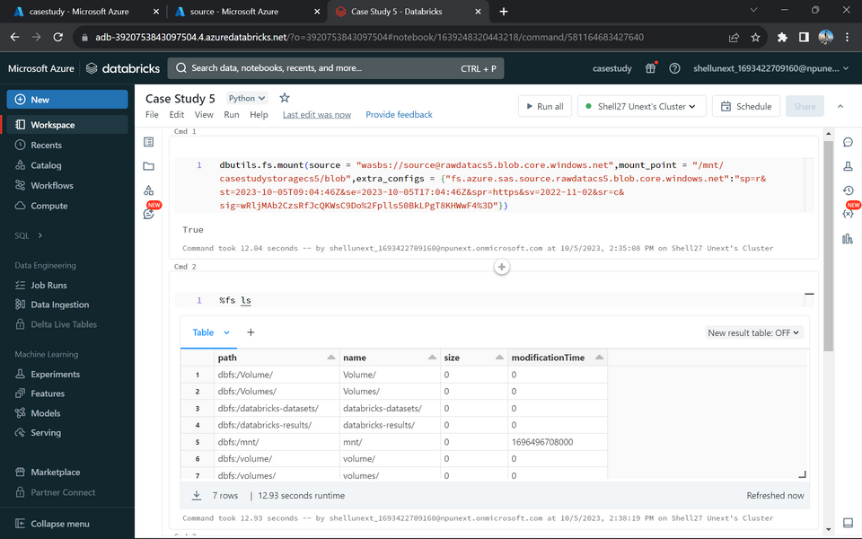
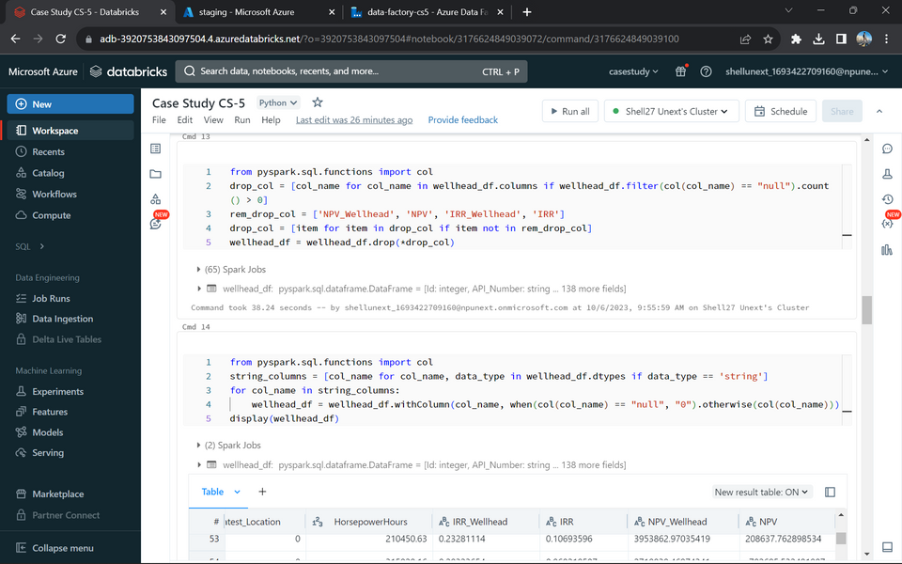
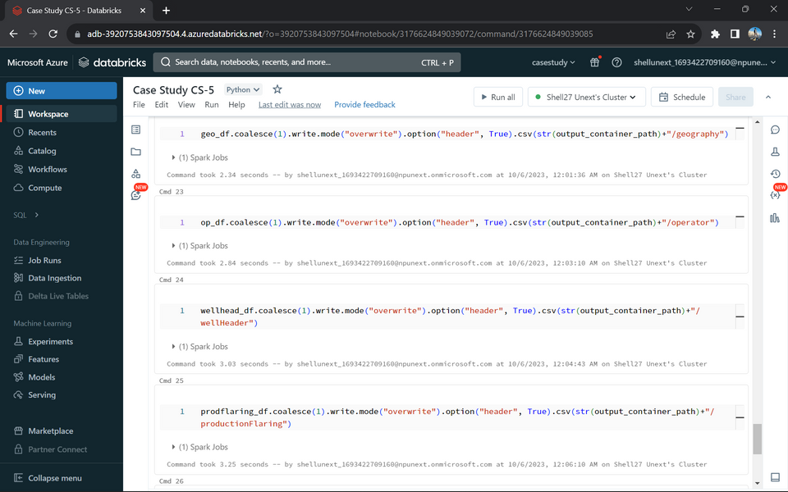
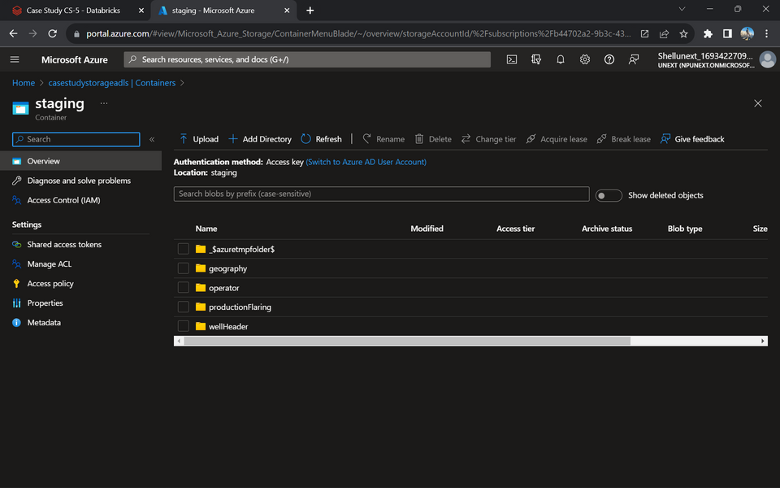
SNAPSHOTS OF DEVELOPMENTS IN EACH LAYER
STAGING

Slide 6
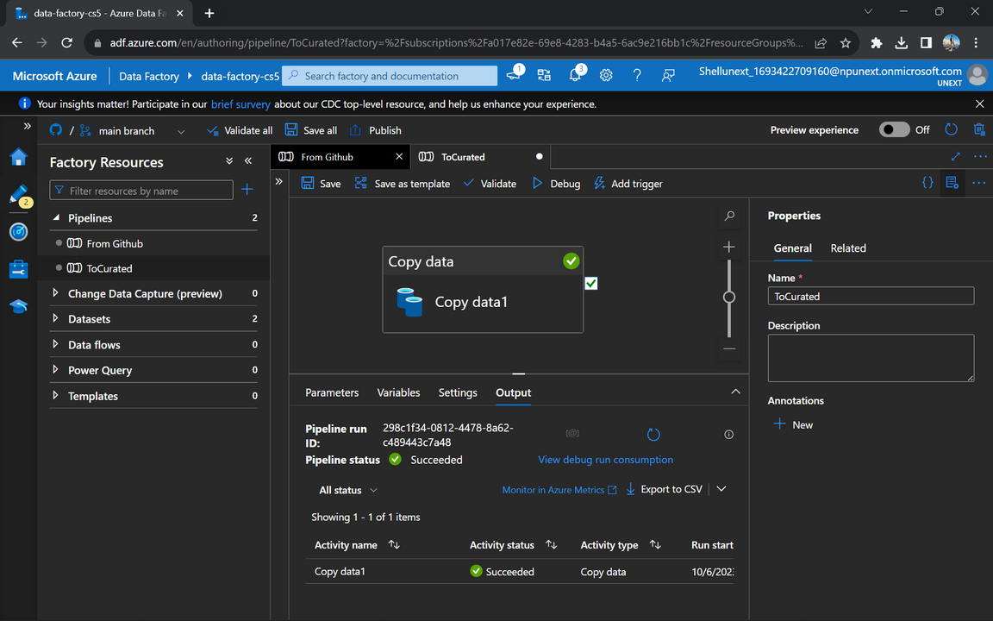
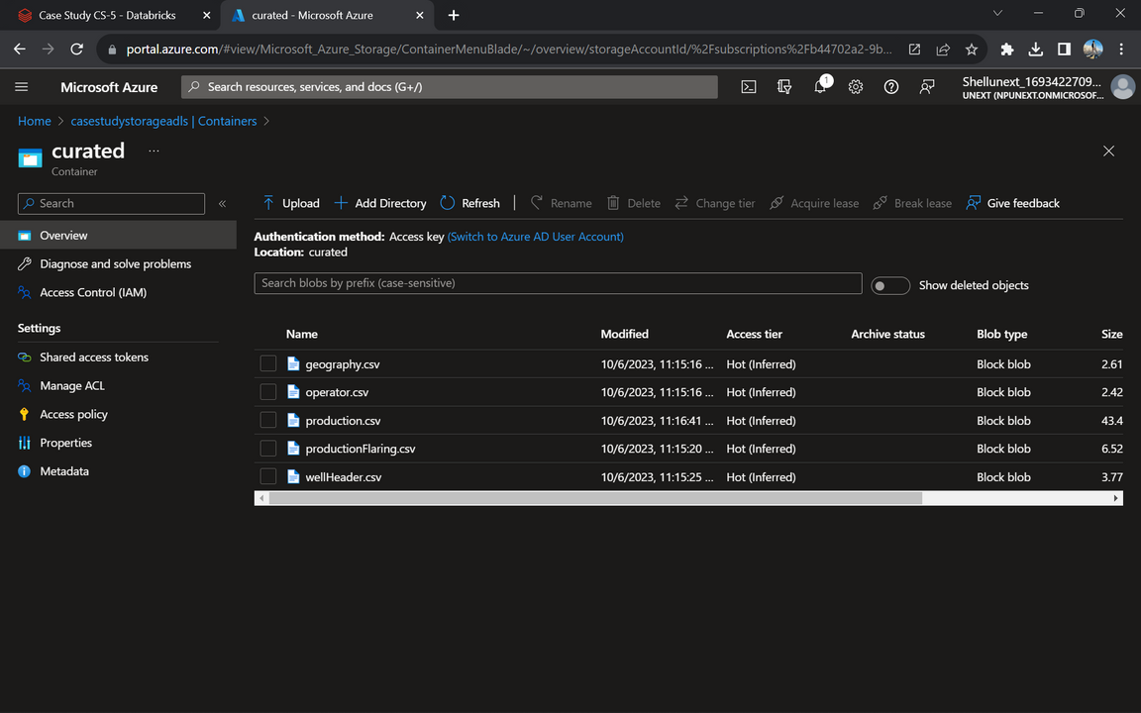
SNAPSHOTS OF DEVELOPMENTS IN EACH LAYER
CURATED

Slide 7
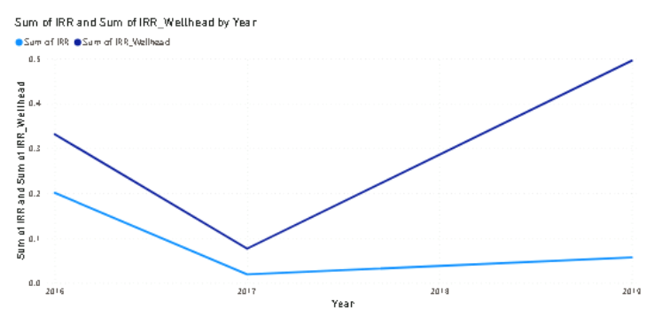
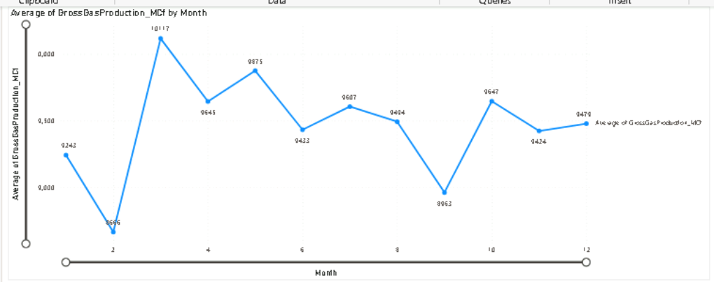
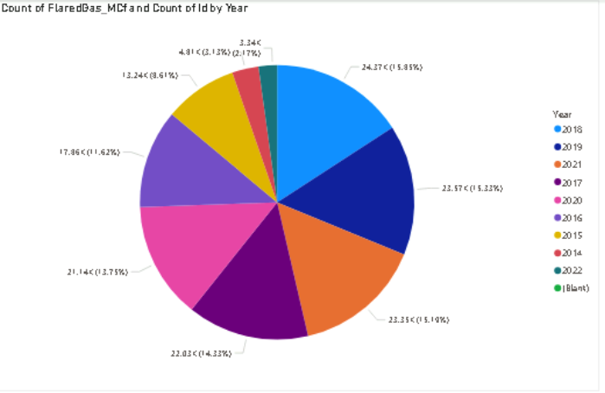
SCREENSHOTS OF DASHBOARD BULIT ON POWER BI

Slide 8
GITHUB LINK OF SOLUTION
aadilsehrawat/ShaleWhaleCube (github.com)

Slide 9
It’s the time for
SYSTEM DEMO

Slide 10
CHALLENGES FACED
Certainly, here are some challenges that we faced while completing the problem statement for the ShaleWellCube case study:
Data Quality Issues
Data Volume
Ensuring the accuracy and completeness of the data in ShaleWellCube was challenging. Inaccurate or missing data can impact the quality of your analysis and conclusions. The datasets were given in an unknown file format that were later converted to .csv
Handling a database with over 1.5 million wells is a significant task. Managing and processing such a large volume of data efficiently can be challenging.
Data Integration
Technical Expertise
Integrating data from various sources and formats into a cohesive dataset can be complex. Ensuring that the data is consistent and standardized is essential for meaningful analysis.
The analysis involves various technical tasks, such as data cleansing, transformation, and using specialized software like Power BI or SQL DW/DB.

Slide 11

Q&A

